Slide 1

Characterising a Situation
Zoom out
Play
Multimodal Data
Remote Monitoring

Slide 2

Trajectory of Health in
Individuals with Long Covid
years after the pandemic

Slide 3





Trajectories of Health in Long Covid
Infection
2020-2022
N=306
LC-
LC+
Clinic visit
2021-2023
LC-S-
152
LC-S+
28
LC+S-
76
LC+S+
50
Mental Health
Cardioresp. Health
Cognitive Function
1 year
Continuous monitoring
ANS
Sleep
Exercise Capacity
Physical Activity
LC-S-
100
LC-S+
18
LC+S-
52
LC+S+
32

Slide 4










Trajectories of Health in Long Covid
Infection
2020-2022
N=306
LC-
LC+
Mental Health
Depression
Anxiety
Wellbeing
Physical Activity
Number of steps
Time spent in MVPA
Clinic visit
2021-2023
LC-S-
152
LC-S+
28
LC+S-
76
LC+S+
50
Mental Health
Exercise Capacity
Walk speed
Peak heart rate
Cardioresp. Health
Cognitive Function
Cognitive function
Composite RT
Composite Accuracy
1 year
Continuous monitoring
ANS
Sleep
Cardiorespiratory Function
Heart rate reserve
Respiratory rate
Exercise Capacity
Physical Activity
Sleep
Duration
Quality
Autonomic Nervous System
Heart rate variability
LC-S-
100
LC-S+
18
LC+S-
52
LC+S+
32

Slide 5
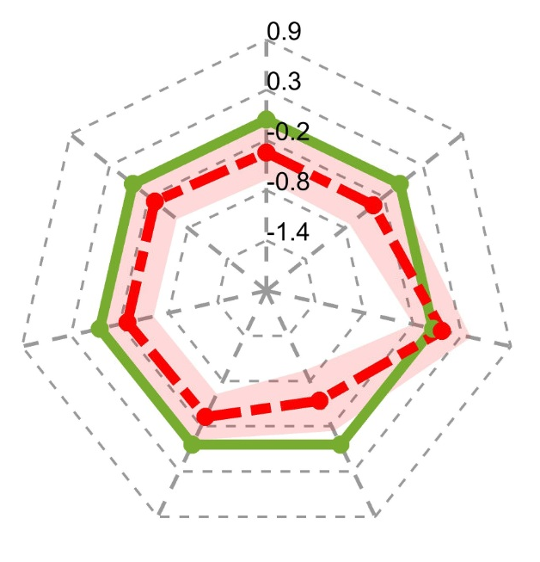
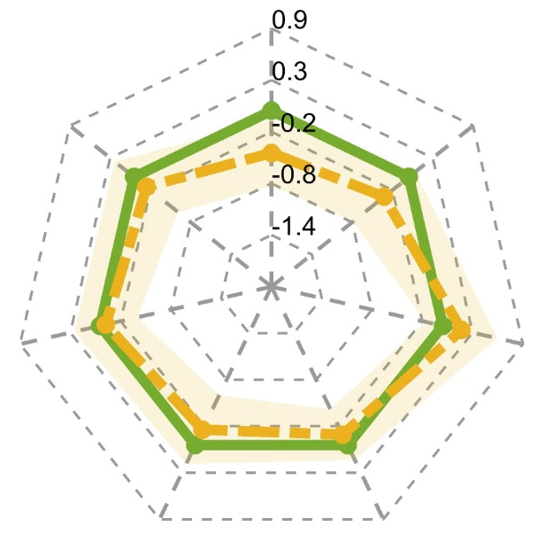
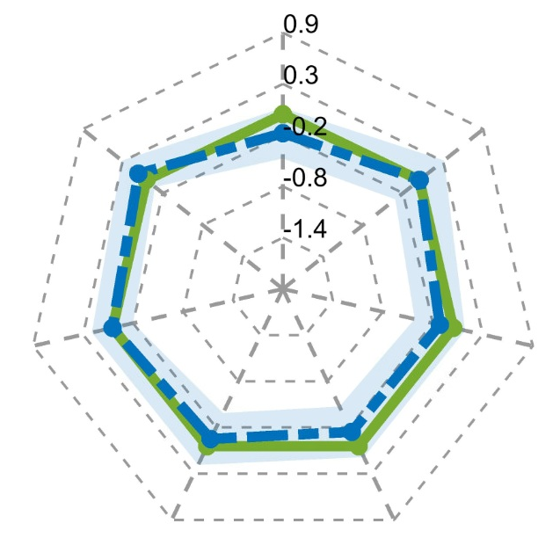
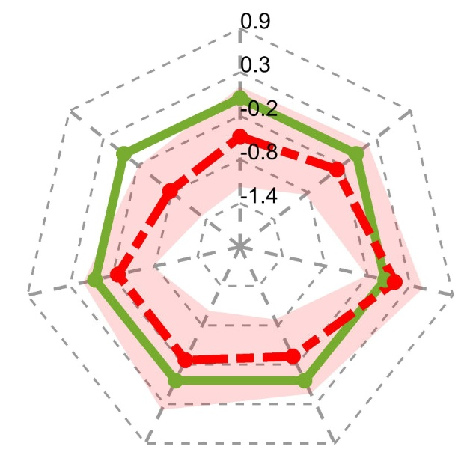
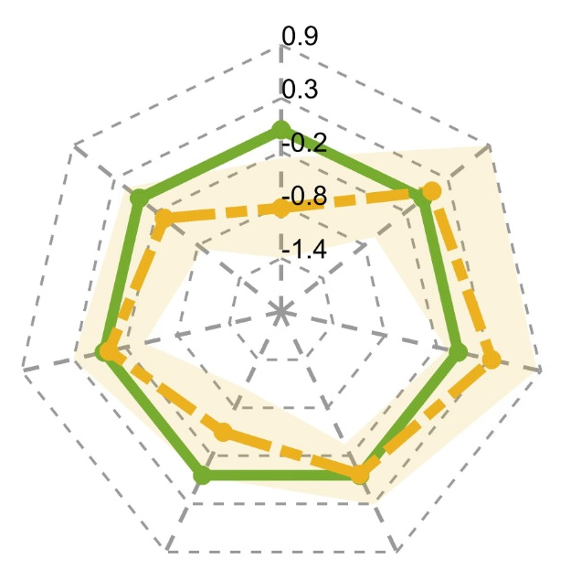
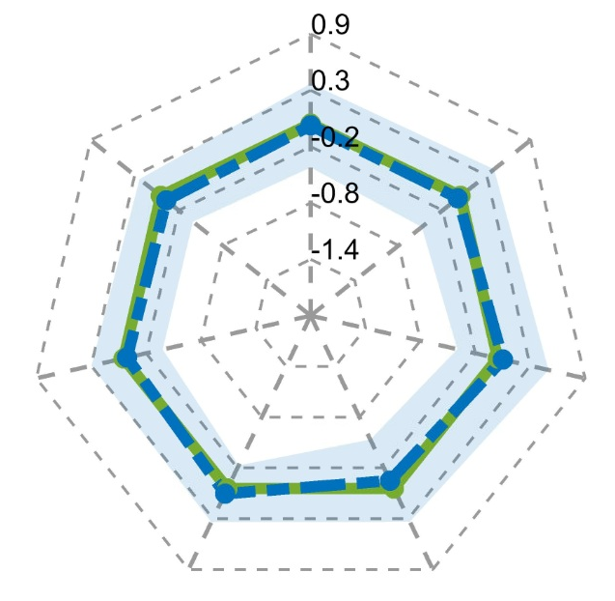
Trajectories of Health in Long Covid
LC+S+
LC-S+
LC+S-
Baseline
1.9 (1.6-2.3) yrs
Post infection
Mental Health
Cardioresp. Health
Cognitive Function
ANS
Sleep
Exercise Capacity
Physical Activity
1year later
2.9 (2.6-3.3) yrs
Post infection

Slide 6



Trajectories of Health in Long Covid
LC+S+
Prof N. Chaturvedi, UCL
Prof A. Hughes, UCL
Prof C. Steves, KCL
Prof N. Timpson, Bristol
Prof R. Dobson, KCL
Dr A. Folarin, KCL
Prof A. Hampshire, KCL
Baseline
1.9 (1.6-2.3) yrs
Post infection
Mental Health
Cardioresp. Health
Cognitive Function
ANS
Sleep
Exercise Capacity
Physical Activity
1year later
2.9 (2.6-3.3) yrs
Post infection

